Slide 1

Algorithmic Analysis
C H A P T E R 10
Without analysis, no synthesis.
—Friedrich Engels, Herr Eugen Dühring’s Revolution in Science, 1878
10.1 The sorting problem
10.2 Computational complexity
10.3 Recursion to the rescue
10.4 Standard complexity classes
10.5 The Quicksort algorithm
10.6 Mathematical induction

Slide 2
The Sorting Problem
Of all the algorithmic problems that computer scientists have studied, the one with the broadest practical impact is certainly the sorting problem, which is the problem of arranging the elements of an array or a vector in order.
The sorting problem comes up, for example, in alphabetizing a telephone directory, arranging library records by catalogue number, and organizing a bulk mailing by ZIP code.
There are many algorithms that one can use to sort an array. Because these algorithms vary enormously in their efficiency, it is critical to choose a good algorithm, particularly if the application needs to work with large arrays.

Slide 3
The Selection Sort Algorithm
Of the many sorting algorithms, the easiest one to describe is selection sort, which appears in the text like this:
void sort(Vector<int> & vec) {
int n = vec.size();
for (int lh = 0; lh < n; lh++) {
int rh = lh;
for (int i = lh + 1; i < n; i++) {
if (vec[i] < vec[rh]) rh = i;
}
int temp = vec[lh];
vec[lh] = vec[rh];
vec[rh] = temp;
}
}
Coding this algorithm as a single function makes sense for efficiency but complicates the analysis. The next two slides decompose selection sort into a set of functions that make the operation easier to follow.

Slide 4
Decomposition of the sort Function
/*
* Function: sort
* --------------
* Sorts a Vector<int> into increasing order. This implementation
* uses an algorithm called selection sort, which can be described
* in English as follows. With your left hand (lh), point at each
* element in the vector in turn, starting at index 0. At each
* step in the cycle:
*
* 1. Find the smallest element in the range between your left
* hand and the end of the vector, and point at that element
* with your right hand (rh).
*
* 2. Move that element into its correct position by swapping
* the elements indicated by your left and right hands.
*/
void sort(Vector<int> & vec) {
for ( int lh = 0 ; lh < vec.size() ; lh++ ) {
int rh = findSmallest(vec, lh, vec.size() - 1);
swap(vec[lh], vec[rh]);
}
}

Slide 5
Decomposition of the sort Function
/*
* Function: sort
* --------------
* Sorts a Vector<int> into increasing order. This implementation
* uses an algorithm called selection sort, which can be described
* in English as follows. With your left hand (lh), point at each
* element in the vector in turn, starting at index 0. At each
* step in the cycle:
*
* 1. Find the smallest element in the range between your left
* hand and the end of the vector, and point at that element
* with your right hand (rh).
*
* 2. Move that element into its correct position by swapping
* the elements indicated by your left and right hands.
*/
void sort(Vector<int> & vec) {
for ( int lh = 0 ; lh < vec.size() ; lh++ ) {
int rh = findSmallest(vec, lh, vec.size() - 1);
swap(vec[lh], vec[rh]);
}
}
/*
* Function: findSmallest
* ----------------------
* Returns the index of the smallest value in the vector between
* index positions p1 and p2, inclusive.
*/
int findSmallest(Vector<int> & vec, int p1, int p2) {
int smallestIndex = p1;
for ( int i = p1 + 1 ; i <= p2 ; i++ ) {
if (vec[i] < vec[smallestIndex]) smallestIndex = i;
}
return smallestIndex;
}
/*
* Function: swap
* --------------
* Exchanges two integer values passed by reference.
*/
void swap(int & x, int & y) {
int temp = x;
x = y;
y = temp;
}

Slide 6



Simulating Selection Sort
int main() {
Vector<int> vec = createTestVector();
sort(vec);
return 0;
}
int main() {
Vector<int> vec = createTestVector();
sort(vec);
return 0;
}
void sort(Vector<int> & vec) {
for ( int lh = 0 ; lh < vec.size() ; lh++ ) {
int rh = findSmallest(vec, lh, vec.size() - 1);
swap(vec[lh], vec[rh]);
}
}
void sort(Vector<int> & vec) {
for ( int lh = 0 ; lh < vec.size() ; lh++ ) {
int rh = findSmallest(vec, lh, vec.size() - 1);
swap(vec[lh], vec[rh]);
}
}
int findSmallest(Vector<int> & vec, int p1, int p2) {
int smallestIndex = p1;
for ( int i = p1 + 1 ; i <= p2 ; i++ ) {
if (vec[i] < vec[smallestIndex]) smallestIndex = i;
}
return smallestIndex;
}
vec
vec
lh
rh
vec
lh
rh
vec
3
6
7
8
0
9
1
2
3
4
5
6
7
8
9
10
smallestIndex
i
p1
p2
vec
1
0
9
2
3
4
5
6
7
8
9
0
10
1
3
6
7
809
503
946
367
987
838
259
236
659
361
809
503
946
367
987
838
259
236
659
361
0
1
2
3
4
5
6
7
8
9
0
1
2
3
4
5
6
7
8
9
skip simulation

Slide 7
Efficiency of Selection Sort
The primary question for today is how one might evaluate the efficiency of an algorithm such as selection sort.
One strategy is to measure the actual time it takes to run for arrays of different sizes. In C++, you can measure elapsed time by calling the time function, which returns the current time in milliseconds. Using this strategy, however, requires some care:
The time function is often too rough for accurate measurement. It therefore makes sense to measure several runs together and then divide the total time by the number of repetitions.
Most algorithms show some variability depending on the data. To avoid distortion, you should run several independent trials with different data and average the results.
Some measurements are likely to be wildly off because the computer needs to run some background task. Such data points must be discarded as you work through the analysis.

Slide 8
Measuring Sort Timings
Because timing measurements are subject to various inaccuracies, it is best to run several trials and then to use statistics to interpret the results. The table below shows the actual running time for the selection sort algorithm for several different values of N, along with the mean (μ) and standard deviation (σ).
The table entries shown in red indicate timing measurements that differ by more than two standard deviations from the average of the other trials (trial #8 for 1000 elements, for example, is more than five times larger than any other trial). Because these outliers probably include background tasks, it is best to discard them.
The following table shows the average timing of the selection sort algorithm after removing outlying trials that differ by more than two standard deviations from the mean. The column labeled μ (the Greek letter mu, which is the standard statistical symbol for the mean) is a reasonably good estimate of running time.
Trial 1
Trial 2
Trial 3
Trial 4
Trial 5
Trial 6
Trial 7
Trial 8
Trial 9
Trial 10
μ
σ
N = 10
.0021
.0025
.0022
.0026
.0020
.0030
.0022
.0023
.0022
.0025
.0024
.00029
20
.006
.007
.008
.007
.007
.011
.011
.007
.007
.007
.007
.007
.00139
.00036
30
.014
.014
.014
.015
.014
.014
.014
.014
.014
.014
.014
.00013
40
.028
.024
.025
.026
.023
.025
.025
.026
.025
.027
.025
.0014
50
.039
.037
.036
.041
.042
.039
.140
.140
.039
.034
.038
.049
.039
.0323
.0025
100
.187
.152
.168
.176
.146
.146
.165
.146
.178
.154
.162
.0151
500
3.94
3.63
4.06
3.76
4.11
3.51
3.48
3.64
3.31
3.45
3.69
0.272
1000
13.40
12.90
13.80
17.60
12.90
14.10
12.70
81.60
81.60
16.00
15.50
21.05
14.32
21.33
1.69
5000
322.5
355.9
391.7
321.6
388.3
321.3
321.3
398.7
322.1
321.3
346.4
33.83
10000
1319.
1388.
1388.
1327.
1318.
1331.
1336.
1318.
1335.
1325.
1319.
1332.
1326.
20.96
7.50

Slide 9
Selection Sort Running Times
Many algorithms that operate on vectors have running times that are proportional to the size of the array. If you multiply the number of values by ten, you would expect those algorithms to take ten times as long.
As the running times on the preceding slide make clear, the situation for selection sort is very different. The table on the right shows the average running time when selection sort is applied to 10, 100, 1000, and 10000 values.
N
time
10
.0024
100
0.162
1000
14.32
10000
1332.
As a rough approximation—particularly as you work with larger values of N—it appears that every ten-fold increase in the size of the array means that selection sort takes about 100 times as long.

Slide 10
Counting Operations
Another way to estimate the running time is to count how many operations are required to sort an array of size N.
In the selection sort implementation, the section of code that is executed most frequently (and therefore contributes the most to the running time) is the body of the findSmallest method. The number of operations involved in each call to findSmallest changes as the algorithm proceeds:
N values are considered on the first call to findSmallest.
N - 1 values are considered on the second call.
N - 2 values are considered on the third call, and so on.
In mathematical notation, the number of values considered in findSmallest can be expressed as a summation, which can then be transformed into a simple formula:
N
N ^{x} (N + 1)
∑
1 + 2 + 3 + . . . + (N - 1) + N =
i
=
2
i = 1

Slide 11
A Geometric Insight
You can convince yourself that
N ^{x} (N + 1)
1 + 2 + 3 + . . . + (N - 2) + (N - 1) + N =
2
by thinking about the problem geometrically.
The terms on the left side of the formula can be arranged into a triangle, as shown at the bottom of this slide for N = 6.
If you duplicate the triangle and rotate it by 180˚, you get a rectangle that in this case contains 6 ^{x} 7 dots, half of which belong to each triangle.

Slide 12
Quadratic Growth
The reason behind the rapid growth in the running time of selection sort becomes clear if you make a table showing the xxx
N ^{x} (N + 1)
value of for various values of N:
2
N ^{x} (N + 1)
N
2
10
55
100
5050
1000
500,500
10000
50,005,000
The growth pattern in the right column is similar to that of the measured running time of the selection sort algorithm. As the x
value of N increases by a factor of 10, the value of xx
N ^{x} (N + 1)
2
increases by a factor of around 100, which is 10². Algorithms whose running times increase in proportion to the square of the problem size are said to be quadratic.

Slide 13
Big-O Notation
The most common way to express computational complexity is to use big-O notation, which was introduced by the German mathematician Paul Bachmann in 1892.
Big-O notation consists of the letter O followed by a formula that offers a qualitative assessment of running time as a function of the problem size, traditionally denoted as N. For example, the computational complexity of linear search is
O ( N )
and the computational complexity of selection sort is
O ( N ² )
If you read these formulas aloud, you would pronounce them as “big-O of N ” and “big-O of N ² ” respectively.

Slide 14

Common Simplifications of Big-O
Given that big-O notation is designed to provide a qualitative assessment, it is important to make the formula inside the parentheses as simple as possible.
When you write a big-O expression, you should always make the following simplifications:
1.
Eliminate any term whose contribution to the running time ceases to be significant as N becomes large.
2.
Eliminate any constant factors.
The computational complexity of selection sort is therefore
O ( N ² )
and not
(
N ^{x} (N + 1)
)
O
2

Slide 15
Deducing Complexity from the Code
In many cases, you can deduce the computational complexity of a program directly from the structure of the code.
The standard approach to doing this type of analysis begins with looking for any section of code that is executed more often than other parts of the program. As long as the individual operations involved in an algorithm take roughly the same amount of time, the operations that are executed most often will come to dominate the overall running time.
In the selection sort implementation, for example, the most commonly executed statement is the if statement inside the findSmallest method. This statement is part of two for loops, one in findSmallest itself and one in Sort. The total number of executions is
1 + 2 + 3 + . . . + (N - 1) + N
which is O(N ²).

Slide 16
Recursion to the Rescue
As long as arrays are small, selection sort is a perfectly workable strategy. Even for 10,000 elements, the average running time of selection sort is just over a second.
The quadratic behavior of selection sort, however, makes it less attractive for the very large arrays that one encounters in commercial applications. Assuming that the quadratic growth pattern continues beyond the timings reported in the table, sorting 100,000 values would require two minutes, and sorting 1,000,000 values would take more than three hours.
The computational complexity of the selection sort algorithm, however, holds out some hope:
Sorting twice as many elements takes four times as long.
Sorting half as many elements takes only one fourth the time.
Is there any way to use sorting half an array as a subtask in a recursive solution to the sorting problem?

Slide 17
The Merge Sort Idea
1.
Divide the vector into two halves: v1 and v2.
2.
Sort each of v1 and v2 recursively.
3.
Clear the original vector.
4
Merge elements into the original vector by choosing the smallest element from v1 or v2 on each cycle.
vec
809
503
946
367
987
838
259
236
659
361
236
259
361
367
503
659
809
838
946
987
809
503
946
367
987
838
259
236
659
361
0
1
2
3
4
5
6
7
8
9
0
1
2
3
4
5
6
7
8
9
v1
809
367
503
503
946
809
367
946
987
987
0
1
2
3
4
v2
838
236
259
259
236
361
659
659
361
838
0
1
2
3
4
Notes:
17

Slide 18
The Merge Sort Implementation
/*
* The merge sort algorithm consists of the following steps:
*
* 1. Divide the vector into two halves.
* 2. Sort each of these smaller vectors recursively.
* 3. Merge the two vectors back into the original one.
*/
void sort(Vector<int> & vec) {
int n = vec.size();
if (n <= 1) return;
Vector<int> v1;
Vector<int> v2;
for (int i = 0; i < n; i++) {
if (i < n / 2) {
v1.add(vec[i]);
} else {
v2.add(vec[i]);
}
}
sort(v1);
sort(v2);
vec.clear();
merge(vec, v1, v2);
}

Slide 19
The Merge Sort Implementation
/*
* The merge sort algorithm consists of the following steps:
*
* 1. Divide the vector into two halves.
* 2. Sort each of these smaller vectors recursively.
* 3. Merge the two vectors back into the original one.
*/
void sort(Vector<int> & vec) {
int n = vec.size();
if (n <= 1) return;
Vector<int> v1;
Vector<int> v2;
for (int i = 0; i < n; i++) {
if (i < n / 2) {
v1.add(vec[i]);
} else {
v2.add(vec[i]);
}
}
sort(v1);
sort(v2);
vec.clear();
merge(vec, v1, v2);
}
/*
* Function: merge
* ---------------
* This function merges two sorted vectors (v1 and v2) into the
* vector vec, which should be empty before this operation.
* Because the input vectors are sorted, the implementation can
* always select the first unused element in one of the input
* vectors to fill the next position.
*/
void merge(Vector<int> & vec, Vector<int> & v1, Vector<int> & v2) {
int n1 = v1.size();
int n2 = v2.size();
int p1 = 0;
int p2 = 0;
while (p1 < n1 && p2 < n2) {
if (v1[p1] < v2[p2]) {
vec.add(v1[p1++]);
} else {
vec.add(v2[p2++]);
}
}
while (p1 < n1) vec.add(v1[p1++]);
while (p2 < n2) vec.add(v2[p2++]);
}

Slide 20
The Complexity of Merge Sort
Sorting 8 items
requires
Two sorts of 4 items
which requires
Four sorts of 2 items
which requires
Eight sorts of 1 item
The work done at each level (i.e., the sum of the work done by all the calls at that level) is proportional to the size of the vector. The running time is therefore proportional to N times the number of levels.

Slide 21
How Many Levels Are There?
The number of levels in the merge sort decomposition is equal to the number of times you can divide the original vector in half until there is only one element remaining. In other words, what you need to find is the value of k that satisfies the following equation:
1 = N / 2 / 2 / 2 / 2 . . . / 2
k times
You can simplify this formula using basic mathematics:
1 = N / 2^{k}
2^{k} = N
k = log₂ N
The complexity of merge sort is therefore O(N log N).

Slide 22
Comparing N ² and N log N
The difference between O(N ²) and O(N log N) is enormous for large values of N, as shown in this table:
N
N ²
N log₂ N
10
100
33
100
10,000
664
1,000
1,000,000
9,966
10,000
100,000,000
132,877
100,000
10,000,000,000
1,660,964
1,000,000
1,000,000,000,000
19,931,569
Based on these numbers, the theoretical advantage of using merge sort over selection sort on a vector of 1,000,000 values would be a factor of more than 50,000.

Slide 23
Standard Complexity Classes
The complexity of a particular algorithm tends to fall into one of a small number of standard complexity classes:
constant
O(1)
Finding first element in a vector
logarithmic
O(log N)
Binary search in a sorted vector
linear
O(N)
Summing a vector; linear search
N log N
O(N log N)
Merge sort
quadratic
O(N ²)
Selection sort
cubic
O(N ³)
Obvious algorithms for matrix multiplication
exponential
O(2^{N})
Tower of Hanoi solution
In general, theoretical computer scientists regard any problem whose complexity cannot be expressed as a polynomial as intractable.

Slide 24
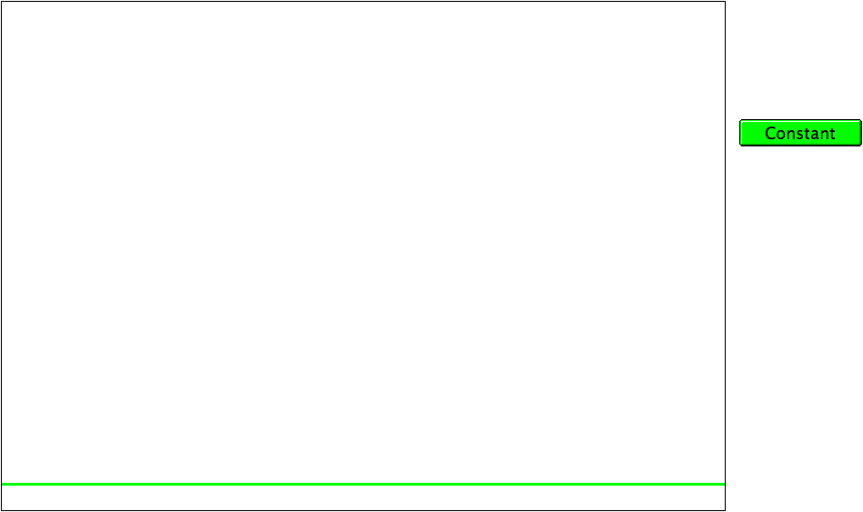
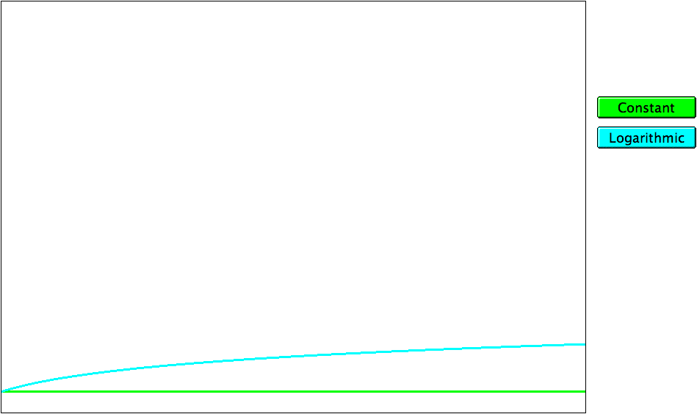
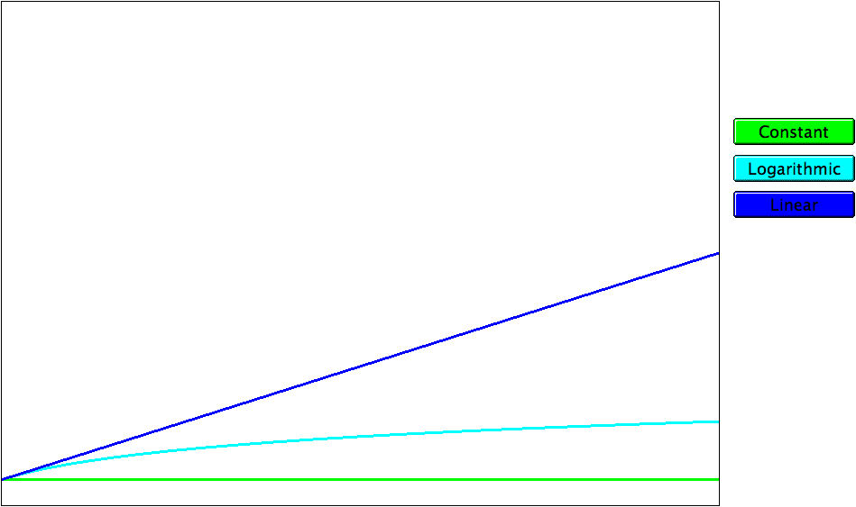
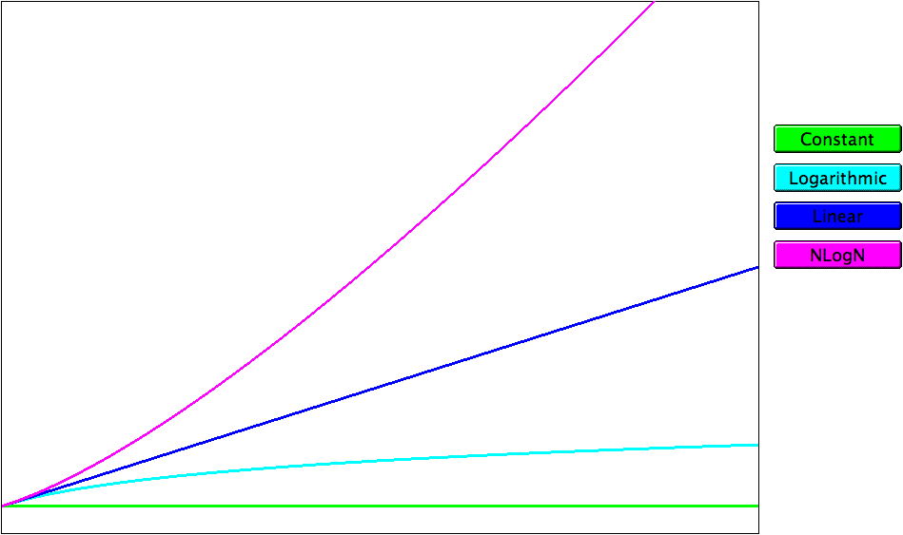
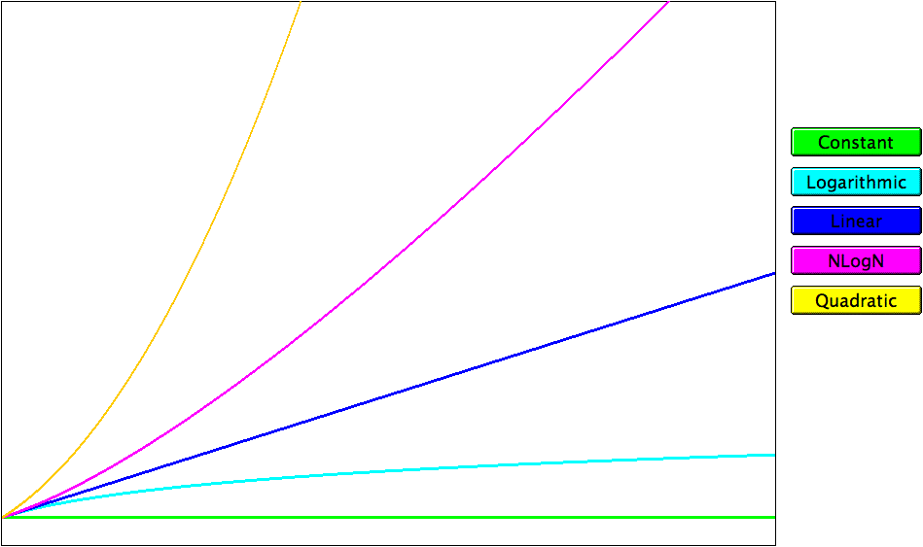
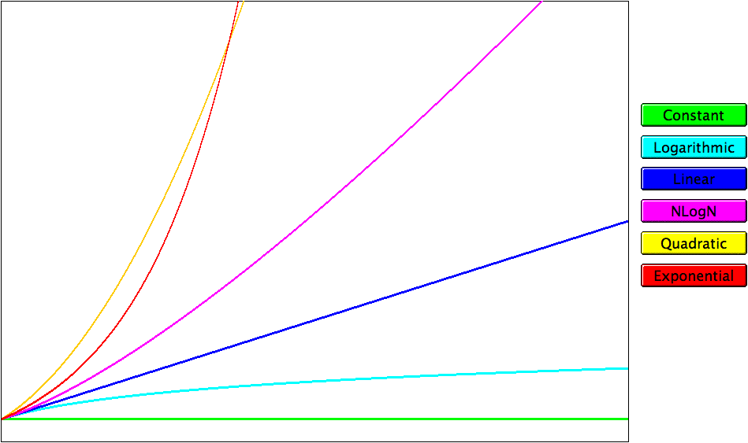
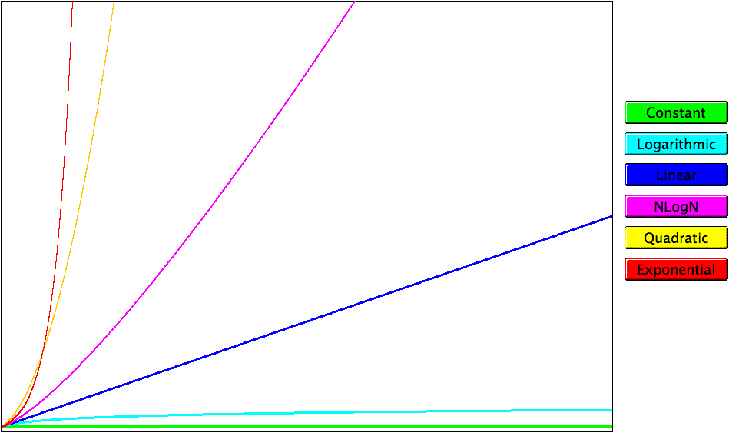
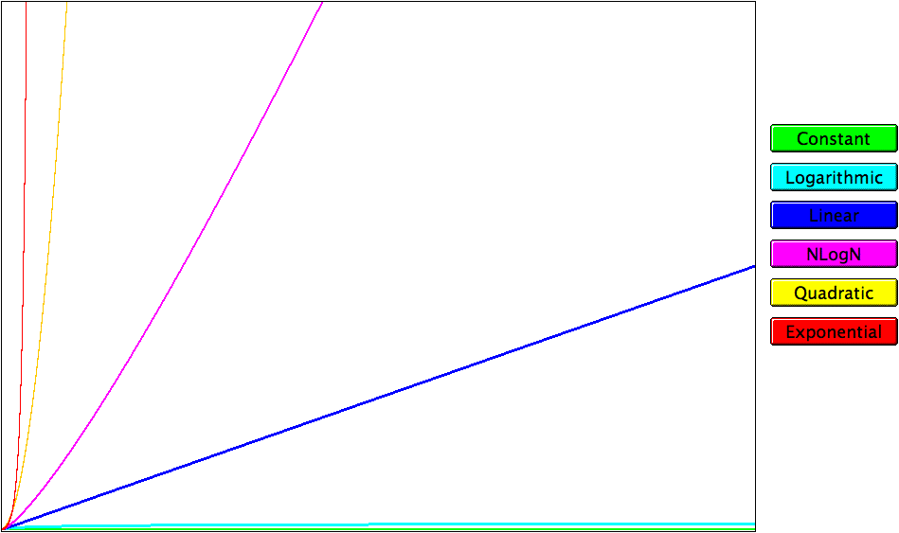
Graphs of the Complexity Classes
running time
problem size

Slide 25
The Quicksort Algorithm
Most sorting libraries use some variation of the Quicksort algorithm, which was developed by Tony Hoare in the 1950s.
The Quicksort algorithm consists of two phases:
1.
Partition. In the partition phase, the elements of the array are reordered so that the array begins with a set of “small” elements and ends with a set of “big” elements, where the distinction between “small” and “big” is made relative to an element called the pivot, which appears at the boundary between the two regions.
2.
Sort. In the sort phase, the Quicksort algorithm is applied recursively to the “small” and “big” subarrays, which leaves the entire array sorted.

Slide 26
Partitioning the Array
809
503
946
809
361
367
987
659
838
236
259
236
838
659
987
946
259
361
0
1
2
3
4
5
6
7
8
9
1.
Select the first element as the pivot and set it aside.
2.
Keep two indices into the remaining elements, starting at each end.
3.
Advance the indices until the left index is larger than the pivot and the right index is smaller.
4.
Exchange the elements at the two indices.
5.
Repeat the process until the indices coincide.
6.
Swap the pivot and the index.

Slide 27
Mathematical Induction
Algorithmic analysis often requires proving properties that apply to all nonnegative integers. For example, the analysis of selection sort depended on the correctness of the following formula:
N
N ^{x} (N + 1)
∑
1 + 2 + 3 + . . . + (N - 1) + N =
i
=
2
i = 1
The most important mathematical technique for proving the correctness of such formulas is mathematical induction, which consists of the following steps:
1.
Prove the base case. In the base case, you prove that the formula holds when N has the basis value, which is typically 0 or 1.
2.
Prove the inductive case. The second step is to show that assuming the formula holds for N, you can prove that it holds for N + 1.

Slide 28
Example of Mathematical Induction
To prove:
N ^{x} (N + 1)
1 + 2 + 3 + . . . + (N - 1) + N =
2
Base case:
0 ^{x} (0 + 1)
0 =
2
Inductive case:
1 + 2 + 3 + . . . + (N - 1) + N + (N + 1)
N ^{x} (N + 1)
=
+ (N + 1)
2
N ^{x} (N + 1)
(2N + 2)
=
+
2
2
N ² + 3N + 2
=
2
(N + 1) ^{x} (N + 2)
=
2

Slide 29
The End

